Slide 1

Intro to object-oriented programming
Chapter 2

Slide 2
What is object-oriented programming?
Introductory courses and books typically teach software development using the procedural programming style, which involves splitting a program into a number of functions (also known as procedures or subroutines). You pass data into functions, each of which performs one or more computations and, typically, passes back results.
This course is about a different paradigm of programming known as object-oriented programming (OOP) that allows programmers to think differently about how to build software. Object-oriented programming gives programmers a way to combine code and data together into cohesive units, thereby avoiding some complications inherent in procedural programming.

Slide 3
Building Software Models of Physical Objects
To describe a physical object in our everyday world, we often reference its attributes. When talking about a desk, you might describe its color, dimensions, weight, material, and so on. Some objects have attributes that apply only to them and not others. A car could be described by its number of doors, but a shirt could not. A box could be sealed or open, empty or full, but those characteristics would not apply to a block of wood. Additionally, some objects are capable of performing actions. A car can go forward, back up, and turn left or right.
To model a real-world object in code, we need to decide what data will represent that object’s attributes and what operations it can perform. These two concepts are often referred to as an object’s state and behavior, respectively:
the state is the data that the object remembers
the behaviors are the actions that the object can do

Slide 4
State and Behavior: Light Switch Example
EXAMPLE

Slide 5
State and Behavior: Light Switch Example
The switch can only be in one of two positions: on or off. To model the state, we only need a single Boolean variable. We name this variable switchIsOn and we say that True means on and False indicates off. When the switch comes from the factory, it is in the off position, so we initially set switchIsOn to False.
Next, we look at the behavior. This switch can only perform two actions: “turn on” and “turn off.” We therefore build two functions, turnOn() and turnOff(), which set the value of the single Boolean variable to True and False, respectively.
This is an extremely simple example, but starting with small functions like these makes the transition to an OOP approach easier
Because we’ve used a global variable to represent the state (in this case, the variable switchIsOn), this code will only work for a single light switch, but one of the main goals of writing functions is to make reusable code. I’ll therefore rebuild the light switch code using object-oriented programming, after introducing the theory first

Slide 6
Introduction to Classes and Objects
The first step to understanding what an object is and how it works is to understand the relationship between a class and an object. I’ll give formal definitions later, but for now, you can think of a class as a template or a blueprint that defines what an object will look like when one is created.
We create objects from a class.

Slide 7
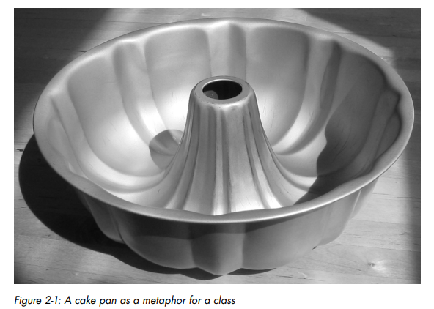
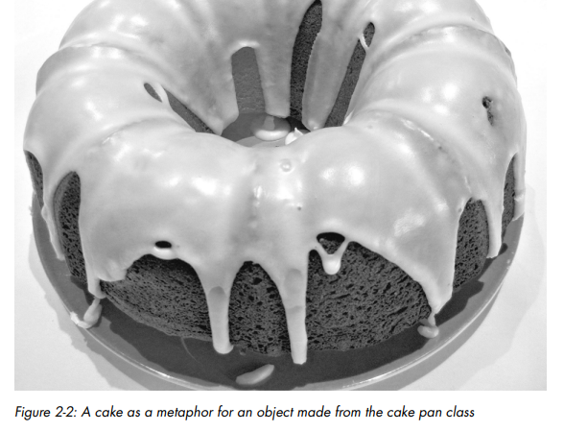
Bundt cake analogy
As an analogy, imagine if we started an on-demand cake-baking business. Being “on-demand,” we only create a cake when an order for one comes in. We specialize in Bundt cakes, and we’ve spent a lot of time developing a cake pan to make sure our cakes are not only tasty but also beautiful and consistent. The pan defines what a Bundt cake will look like when we create one, but it certainly is not a cake.
The pan represents our class. When an order comes in, we create a Bundt cake from our pan. The cake is an object made using the cake pan. Using the pan, we can create any number of cakes. Our cakes could have different attributes, like different flavors, different types of frosting, and optional extras like chocolate chips, but all the cakes will come from the same cake pan

Slide 8
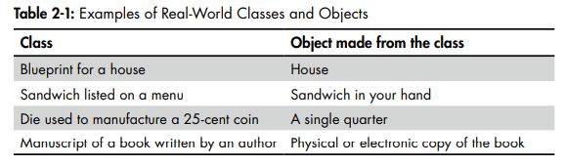
Examples

Slide 9
Classes, Objects, and Instantiation
Class - Code that defines what an object will remember (its data or state) and the things that it will be able to do (its functions or behavior).
To get a feel for what a class loo ks like, let's rewrite the code of a light switch from a function to a class
EXAMPLE

Slide 10
instantation
Another word that you’ll come across in OOP is instance. The words instance and object are essentially interchangeable; however, to be precise, we would say that a LightSwitch object is an instance of the LightSwitch class.
Instantation - The process of creating an object from a class
In the previous assignment statement, we went through the instantiation process to create a LightSwitch object from the LightSwitch class. We can also use this as a verb; we instantiate a LightSwitch object from the LightSwitch class

Slide 11
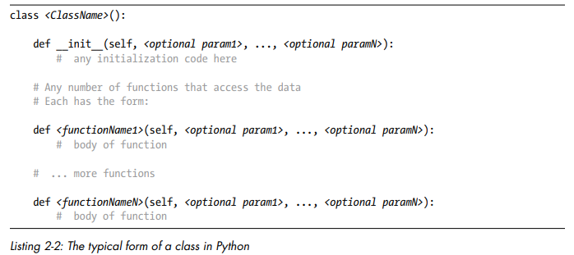
Writing a class in python
Let’s discuss the different parts of a class and the details of instantiating and using an object
You begin a class definition with a class statement specifying the name you want to give the class. The convention for class names is to use camel case, with the first letter uppercase (for example, LightSwitch). Following the name you can optionally add a set of parentheses, but the statement must end with a colon to indicate that you’re about to begin the body of the class
Within the body of the class, you can define any number of functions. All the functions are considered part of the class, and the code that defines them must be indented. Each function represents some behavior that an object created from the class can perform.
All functions must have at least one parameter, which by convention is named self

Slide 12
WRITING A CLASS IN PYTHON
OOP functions are given a special name: method.
Method - A function defined inside a class. A method always has at least one parameter, which is usually named self.
The first method in every class should have the special name __init__. Whenever you create an object from a class, this method will run automatically. Therefore, this method is the logical place to put any initialization code that you want to run whenever you instantiate an object from a class.
The name __init__ is reserved by Python for this very task, and it must be written exactly this way, with two underscores before and after the word init (which must be lowercase). In reality, the __init__() method is not strictly required. However, it’s generally considered good practice to include it and use it for initialization.

Slide 13
Scope and Instance Variables
In procedural programming, there are two principal levels of scope: variables created in the main code have global scope and are available anywhere in a program, while variables created inside a function have local scope and only live as long as the function runs. When the function exits, all local variables (variables with local scope) literally go away
Object-oriented programming and classes introduce a third level of scope, typically called object scope, though sometimes referred to as class scope or more rarely as instance scope. They all mean the same thing: the scope consists of all the code inside the class definition.

Slide 14
SCOPE AND INSTANCE VARIABLES
Methods can have both local variables and instance variables.
In a method, any variable whose name does not start with self. is a local variable and will go away when that method exits, meaning other methods within the class can no longer use that variable.
Instance variables have object scope, which means they are available to all methods defined in a class. Instance variables and object scope are the keys to understanding how objects remember data.

Slide 15
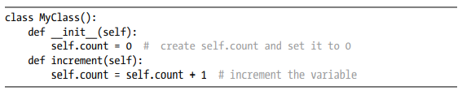
SCOPE AND INSTANCE VARIABLES
Just like local and global variables, instance variables are created when they are first given a value and do not need any special declaration. The __init__() method is the logical place to initialize instance variables.
Here we have an example of a class where the __init__() method initializes an instance variable self.count (read as “self dot count”) to zero and another method, increment(), that simply adds 1 to self.count

Slide 16
SCOPE AND INSTANCE VARIABLES
When you instantiate an object from the MyClass class, the __init__() method runs and sets the value of the instance variable self.count to zero. If you then call the increment() method, the value of self.count goes from zero to one. If you call increment() again, the value goes from one to two, and on and on.
Each object created from a class gets its own set of instance variables, independent of any other objects instantiated from that class.
In the case of the LightSwitch class, there is only one instance variable, self.switchIsOn, so every LightSwitch object will have its own self.switchIsOn. Therefore, you can have multiple LightSwitch objects, each with its own independent value of True or False for its self.switchIsOn variable

Slide 17
Differences Between Functions and Methods
To recap, there are three key differences between a function and a method:
All methods of a class must be indented under the class statement.
All methods have a special first parameter that (by convention) is named self.
Methods in a class can use instance variables, written in the form self.<variableName>
Now that you know what methods are, let's llok at how we can create an object from a class and how to use the different methods that are available in a class.

Slide 18
Creating an Object from a Class
As I said earlier, a class simply defines what an object will look like. To use a class, you have to tell Python to make an object from the class. The typical way to do this is to use an assignment statement like this:
<object> = <ClassName>(<optional arguments>)
This single line of code invokes a sequence of steps that ends with Python handing you back a new instance of the class, which you typically store into a variable. That variable then refers to the resulting object.

Slide 19
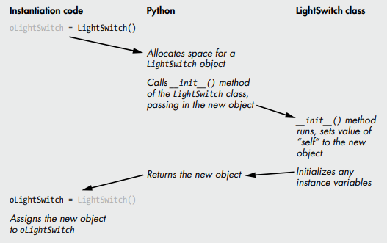
THe instantiation process
The graph on the right shows the steps involved in instantiating a LightSwitch object from the LightSwitch class, going from the assignment statement into Python, then to the code of the class, then back out through Python again, and finally back to the assignment statement

Slide 20
Calling methods of an object
After creating an object from a class, to call a method of the object, you use the generic syntax:
<object>.<methodName>(<any arguments>)
EXAMPLE

Slide 21
Creating Multiple Instances from the Same Class
One of the key features of OOP is that you can instantiate as many objects as you want from a single class, in the same way that you can make endless cakes from a Bundt cake pan. So, if you want two light switch objects, or three, or more, you can just create additional objects from the LightSwitch class
EXAMPLE
The important point here is that each object that you create from a class maintains its own version of the data. In this case, oLightSwitch1 and oLightSwitch2 each have their own instance variable, self.switchIsOn. Any changes you make to the data of one object will not affect the data of another object. You can call any of the methods in the class with either object

Slide 22
CREATING MULTIPLE INSTANCES FROM THE SAME CLASS
Let's create two light switch objects and call methods on the different objects
EXAMPLE
The code tells oLightSwitch1 to turn itself on and tells oLightSwitch2 to turn itself off. Notice that the code in the class has no global variables. Each LightSwitch object gets its own set of any instance variables (just one in this case) defined in the class. While this may not seem like a huge improvement over having two simple global variables that could be used to do the same thing, the implications of this technique are enormous.

Slide 23
Python Data Types Are Implemented as Classes
It might not surprise you that all built-in data types in Python are implemented as classes. Here is a simple example:
myString = 'abcde'
print(type(myString))
#Output is <class 'str'>
We assign a string value to a variable. When we call the type() function and print the results, we see that we have an instance of the str string class. The str class gives us a number of methods we can call with strings, including myString.upper(), myString.lower(), myString.strip(), and so on

Slide 24
PYTHON DATA TYPES ARE IMPLEMENTED AS CLASSES
Lists work in a similar way:
myList = [10, 20, 30, 40]
print(type(myList))
#Output is <class 'list'>
All lists are instances of the list class, which has many methods including myList.append(), myList.count(), myList.index(), and so on.

Slide 25
PYTHON DATA TYPES ARE IMPLEMENTED AS CLASSES
When you write a class, you are defining a new data type. Your code provides the details by defining what data it maintains and what operations it can perform. After creating an instance of your class and assigning it to a variable, you can use the type() built-in function to determine the class used to create it, just like with a built-in data type.
Here we instantiate a LightSwitch object and print out its data type:
oLightSwitch = LightSwitch()
print(type(oLightSwitch))
#Output is <class 'LightSwitch'>
Just like with Python’s built-in data types, we can then use the variable oLightSwitch to call the methods available in the oLightSwitch class.

Slide 26
Definition of an object
Object - Data, plus code that acts on that data, over time.
To summarize:
A class defines what an object will look like when you instantiate one.
An object is a set of instance variables and the code of the methods in the class from which the object was instantiated.
Any number of objects can be instantiated from a class, and each has its own set of instance variables.
When you call a method of an object, the method runs and uses the set of instance variables in that object.

Slide 27
Building a Slightly More Complicated Class
Let’s build on the concepts introduced so far and work through a second, slightly more complicated example in which we’ll make a dimmer switch class.
A dimmer switch has an on/off switch, but it also has a multiposition slider that affects the brightness of the light. The slider can move through a range of brightness values. To make things straightforward, our dimmer digital slider has 11 positions, from 0 (completely off) through 10 (completely on). To raise or lower the brightness of the bulb to the maximum extent, you must move the slider through every possible setting.

Slide 28
Dimmerswitch class
This DimmerSwitch class has more functionality than our LightSwitch class and needs to remember more data:
The switch state (on or off)
Brightness level (0 to 10)
And here are the behaviors a DimmerSwitch object can perform:
Turn on
Turn off
Raise level
Lower level
Show (for debugging)
EXAMPLE

Slide 29
Representing a More Complicated Physical Object as a Class
Let’s consider a more complicated physical object: a television. With this more complicated example, we’ll take a closer look at how arguments work in classes. A television requires much more data than a light switch to represent its state, and it has more behaviors. To create a TV class, we must consider how a user would typically use a TV and what the TV would have to remember

Slide 30
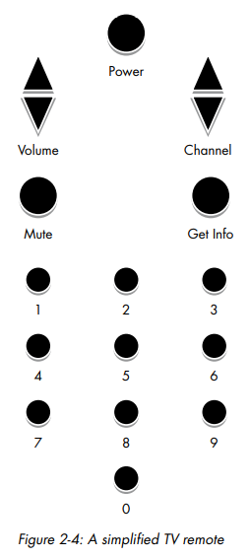
TV class
From this picture, we can determine that to keep track of its state, a TV class would have to maintain the following data:
Power state (on or off)
Mute state (is it muted?)
List of channels available
Current channel setting • Current volume setting
Range of volume levels available
And the actions that the TV must provide include:
Turn the power on and off
Raise and lower the volume
Change the channel up and down
Mute and unmute the sound
Get information about the current settings
Go to a specific channel

Slide 31
TV CLAss
EXAMPLE

Slide 32
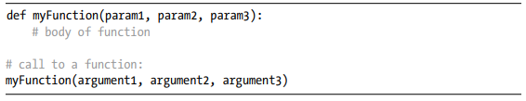
Passing Arguments to a Method
When calling any function, the number of arguments must match the number of parameters listed in the matching def statement:
The same rule applies with methods and method calls. However, you may notice that whenever we make a call to a method, it appears that we are specifying one less argument than the number of parameters. For example, the definition of the power() method in our TV class looks like this:
This implies that the power() method is expecting one value to be passed in and whatever is passed in will be assigned to the variable self. Yet when we started by turning on the TV , we made this call:

Slide 33

This may seem even stranger in the case of the setChannel() method. The method is written to accept two parameters
But we called setChannel() like this:
It appears that only one value is being passed in. You might expect Python to generate an error here, due to a mismatch in the number of arguments (one) and the number of parameters (two). In practice, Python is doing a bit of behind-the-scenes work to make the syntax easier to follow.

Slide 34
Let’s examine this. Earlier, I said that to make a call to a method of an object, you use the following generic syntax:
Python takes the <object> you specify in the call and rearranges it to become the first argument. Any values in the parentheses of the method call are considered the subsequent argument(s). Thus, Python makes it appear that you wrote this instead:

Slide 35
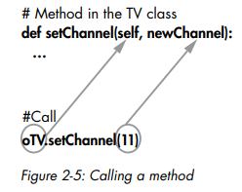
Although it looks like we’re only providing one argument here (for newChannel), there are really two arguments passed in—oTV and 11—and the method provides two parameters to receive these values (self and newChannel, respectively).
Python rearranges the arguments for us when the call is made. This may seem odd at first, but it will become second nature very quickly. Writing the call with the object first makes it much easier for a programmer to see which object is being acted on.
This is a subtle but important feature. Remember that the object (in this case, oTV) keeps the current settings of all of its instance variables. Passing the object as the first argument allows the method to run with the values of the instance variables of that object.

Slide 36
Multiple instances
Every method is written with self as the first parameter, so the self variable receives the object used in each call. This has a major implication: it allows any method within a class to work with different objects.
We’ll create two TV objects and save them in two variables, oTV1 and oTV2. Each TV object has a volume setting, a channel list, a channel setting, and so on. We’ll make calls to a number of different methods of the different objects. At the end, we’ll call the showInfo() method on each TV object to see the resulting settings
EXAMPLE
Each TV object maintains its own set of the instance variables defined in the class. This way, each TV object’s instance variables can be manipulated independently of those of any other TV object.

Slide 37
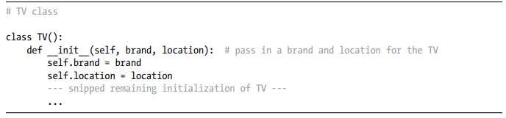
Initialization Parameters
The ability to pass arguments to method calls also works when instantiating an object. So far, when we’ve created our objects, we’ve always set their instance variables to constant values. However, you’ll often want to create different instances with different starting values. For example, imagine we want to instantiate different TVs and identify them using their brand name and location. This way, we can differentiate between a Samsung television in the family room and a Sony television in the bedroom. Constant values would not work for us in this situation.
To initialize an object with different values, we add parameters to the definition of the __init__() method, like this
In all methods, parameters are local variables, so they literally go away when the method ends. For example, in the __init__() method of the TV class shown here, brand and location are local variables that will disappear when the method ends. However, we often want to save values that are passed in via parameters to use them in other methods.

Slide 38


INITIALIZATION PARAMETERS
In order to allow an object to remember initial values, the standard approach is to store any values passed in into instance variables. Since instance variables have object scope, they can be used in other methods in the class. The Python convention is that the name of the instance variable should be the same as the parameter name, but prefixed with self and a period:
In the TV class, the line after the def statement tells Python to take the value of the brand parameter and assign it to an instance variable named self.brand. The next line does the same thing with the location parameter and the instance variable self.location. After these assignments, we can use self.brand and self.location in other methods.
Using this approach, we can create multiple objects from the same class but start each off with different data. So, we can create our two TV objects like this:
EXAMPLE

Slide 39
Classes in Use
Using everything we’ve learned in this chapter, we can now create classes and build multiple independent instances from those classes. Here are a few examples of how we might use this:
Say we wanted to model a student in a course. We could have a Student class that has instance variables for name, emailAddress, currentGrade, and so on. Each Student object we create from this class would have its own set of these instance variables, and the values given to the instance variables would be different for each student.
Consider a game where we have multiple players. A player could be modeled by a Player class with instance variables for name, points, health, location, and so on. Each player would have the same capabilities, but the methods could work differently based on the different values in the instance variables.
Imagine an address book. We could create a Person class with instance variables for name, address, phoneNumber, and birthday. We could create as many objects from the Person class as we want, one for each person we know. The instance variables in each Person object would contain different values. We could then write code to search through all the Person objects and retrieve information about the one or ones we are looking for

Slide 40
OOP as a Solution
A well-written class can be easily reused in many different programs. Classes do not need to access global data. Instead, objects provide code and data at the same level.
Object-oriented programming can greatly reduce the number of global variables required, because a class provides a framework in which data and code that acts on the data exist in one grouping. This also tends to make code easier to debug.
Objects created from a class only have access to their own data—their set of the instance variables in the class. Even when you have multiple objects created from the same class, they do not have access to each other’s data.

